Slide 1
Convolutional Neural Networks 1

Slide 2

A Convolutional Network
+ ReLU
+ ReLU

Slide 3
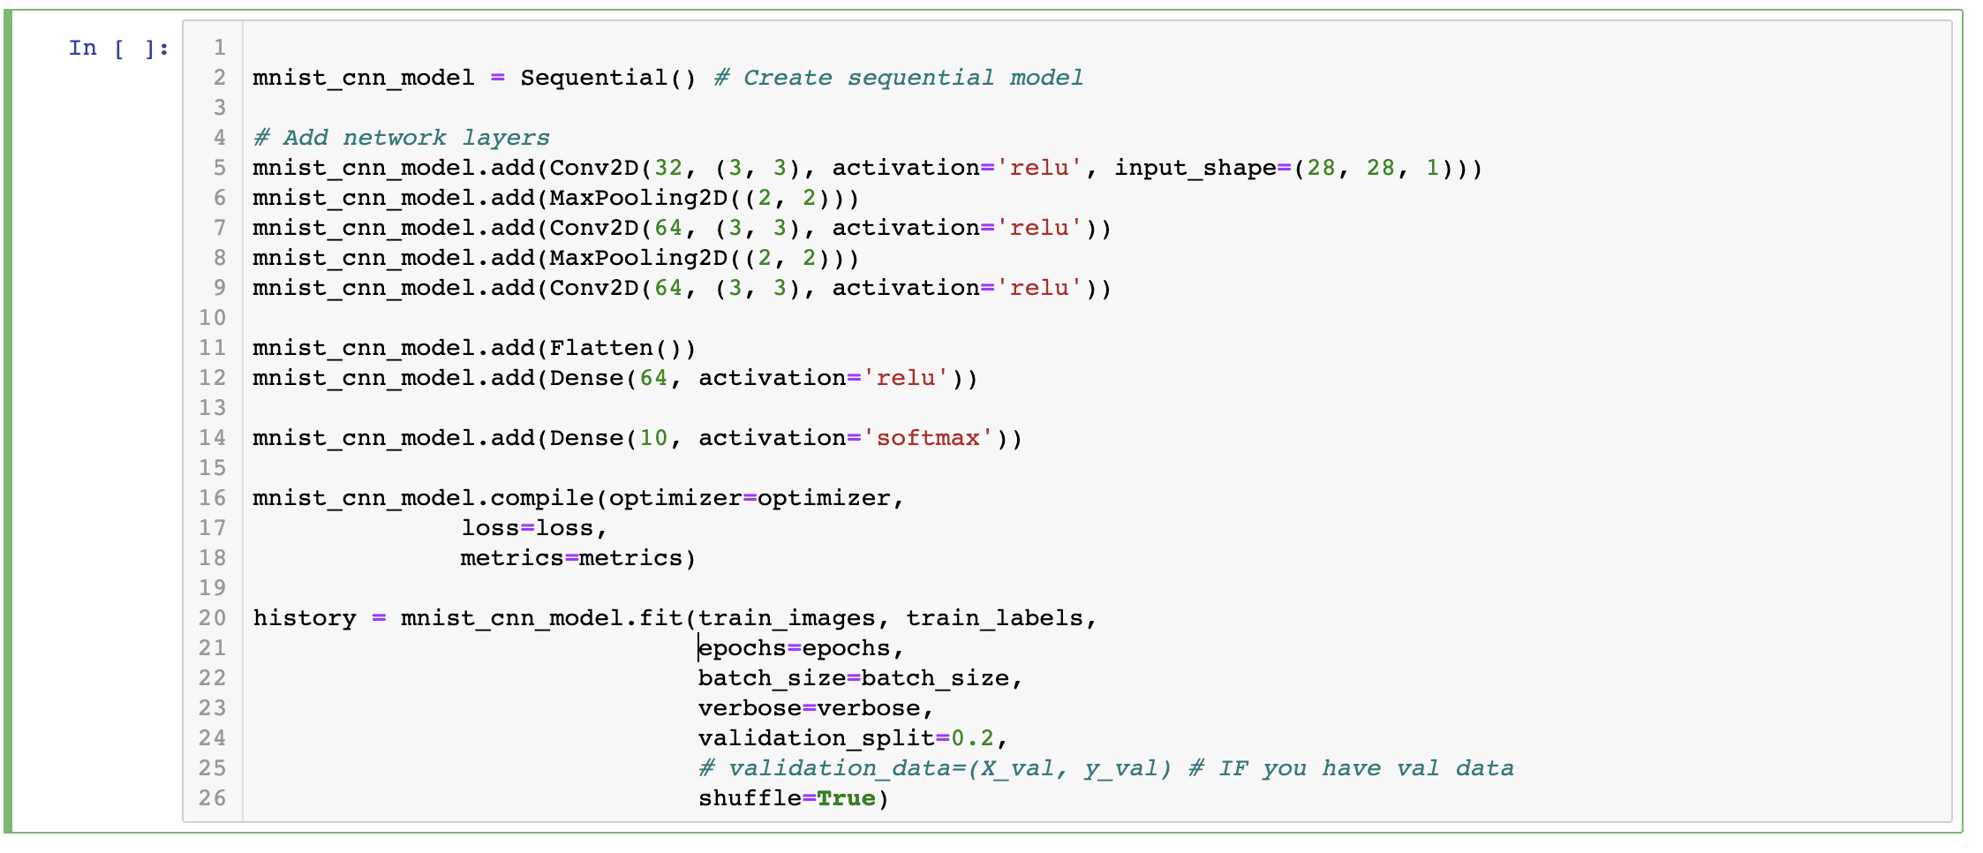
The code

Slide 4
DONE

Slide 5
A Convolutional Network
+ ReLU
+ ReLU
What is this square?

Slide 6
A Convolutional Network
+ ReLU
+ ReLU
What is this square?
What are feature maps and why are there multiple feature maps?

Slide 7
A Convolutional Network
+ ReLU
+ ReLU
What is this square?
What are feature maps and why are there multiple feature maps?
What is Pooling?

Slide 8
A Convolutional Network
+ ReLU
Why is there more than one layer?
+ ReLU
What is this square?
What are feature maps and why are there multiple feature maps?
What is Pooling?

Slide 9
A Convolutional Network
+ ReLU
Why is there more than one layer?
+ ReLU
What is this square?
What are feature maps and why are there multiple feature maps?
What is going on here?
What is Pooling?

Slide 11
Outline
Motivation
CNN basic ideas
Building a CNN

Slide 12
Outline
Motivation
CNN basic ideas
Building a CNN

Slide 13
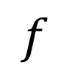
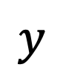
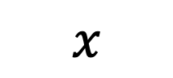
Feed forward Neural Network, Multilayer Perceptron (MLP)
A function is a relation that associates each element $x$ of a set $X$ to a single element $y$ of a set $Y$
$$x$$
$$f$$
$$y$$

Slide 14
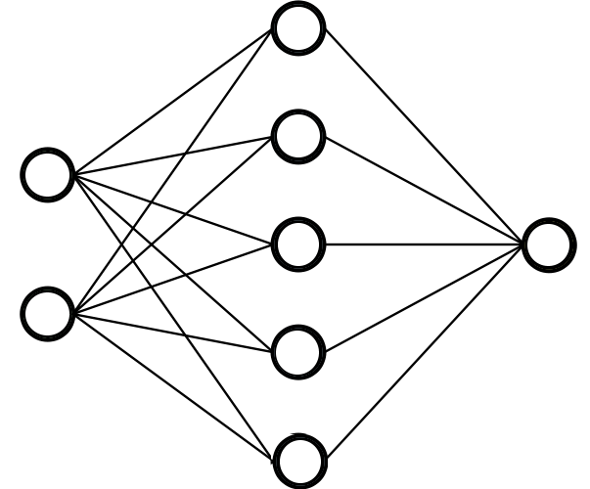
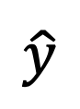

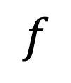
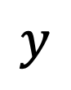
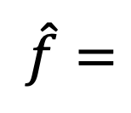
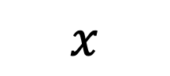
Feed forward Neural Network, Multilayer Perceptron (MLP)
A function is a relation that associates each element $x$ of a set $X$ to a single element $y$ of a set $Y$
$$x$$
$$f$$
$$y$$
Neural networks can approximate a wide variety of functions
$$x$$
$\hat{f}=$
$$\hat{y}$$

Slide 15
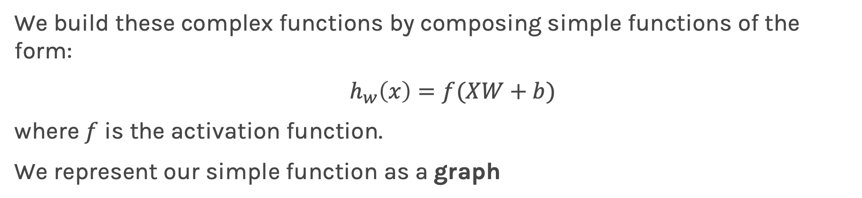
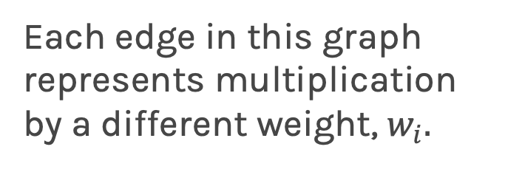
Graphical representation of simple functions
We build these complex functions by composing simple functions of the form:
$h_{w}\left(x\right)=f(XW+b)$
where $f$ is the activation function.
We represent our simple function as a graph
Each edge in this graph represents multiplication by a different weight, $w_{i}.$

Slide 16
Quick review of MLPs
Loss function
input
output layer
hidden layer 1
hidden layer 2

Slide 17
Quick review of MLPs
I do not like calling it a layer
Loss function
input
output layer
hidden layer 1
hidden layer 2

Slide 18
Quick review of MLPs
Activation depends on task
I do not like calling it a layer
Loss function
input
output layer
hidden layer 1
hidden layer 2

Slide 19
Quick review of MLPs
Activation depends on task
I do not like calling it a layer
Loss function
input
output layer
Loss function depends on task
hidden layer 1
hidden layer 2

Slide 20
Quick review of MLPs
Activation depends on task
I do not like calling it a layer
Loss function
input
output layer
Loss function depends on task
hidden layer 1
hidden layer 2
Learn weights and biases using backpro and gradient descent

Slide 21
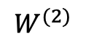
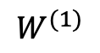
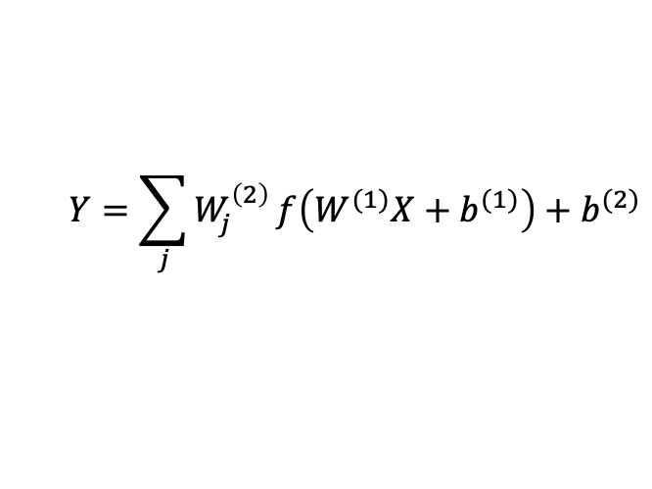
MLP as an additive model
activation
$$W^{(1)}$$
$$W^{(2)}$$
$$Y=\sum_{j}{W_{j}^{\left(2\right)}}f\left(W^{(1)}X+b^{(1)}\right)+b^{(2)}$$
X
Y
input
output layer
hidden layer 1

Slide 22
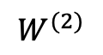
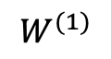
MLP as an additive model
activation
$$W^{(1)}$$
$$W^{(2)}$$
$$Y=\sum_{j}{W_{j}^{\left(2\right)}}f\left(W^{(1)}X+b^{(1)}\right)+b^{(2)}$$
X
Y
Basis functions.
input
output layer
hidden layer 1

Slide 23
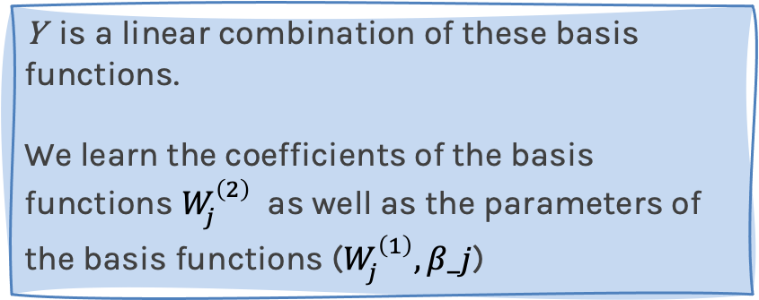
MLP as an additive model
activation
$$W^{(1)}$$
$$W^{(2)}$$
$$Y=\sum_{j}{W_{j}^{\left(2\right)}}f\left(W^{(1)}X+b^{(1)}\right)+b^{(2)}$$
X
Y
Basis functions.
input
Y is a linear combination of these basis functions.
We learn the coefficients of the basis functions $W_{j}^{\left(2\right)}$ as well as the parameters of the basis functions ($W_{j}^{\left(1\right)}, β_j$)
output layer
hidden layer 1

Slide 24

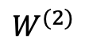
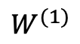
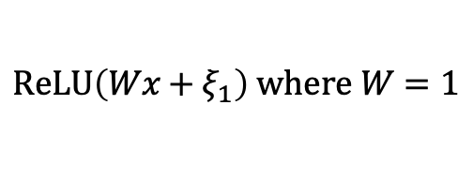
MLP as an additive model (cont)
From lecture 1:
E(Y|x)$=α_{0}+α_{1}x+β_{1}{\left(x−ξ_{1}\right)}_{+}$+$β_{2}{\left(x−ξ_{2}\right)}_{+}+…+β_{k}{\left(x−ξ_{k}\right)}_{+}$
Minor modification:
E(Y|x)$=α_{0}+β_{0}{\left(x−∞\right)}_{+}+β_{1}{\left(x−ξ_{1}\right)}_{+}$+$β_{2}{\left(x−ξ_{2}\right)}_{+}+…+β_{k}{\left(x−ξ_{k}\right)}_{+}$
$$ReLU\left(Wx+ξ_{1}\right) where W=1$$
$$W^{(1)}$$
$$W^{(2)}$$
Location of Knots can be learned as well as the $β$’s and $α_{0}$
X
Y
input layer
hidden layer 1

Slide 25
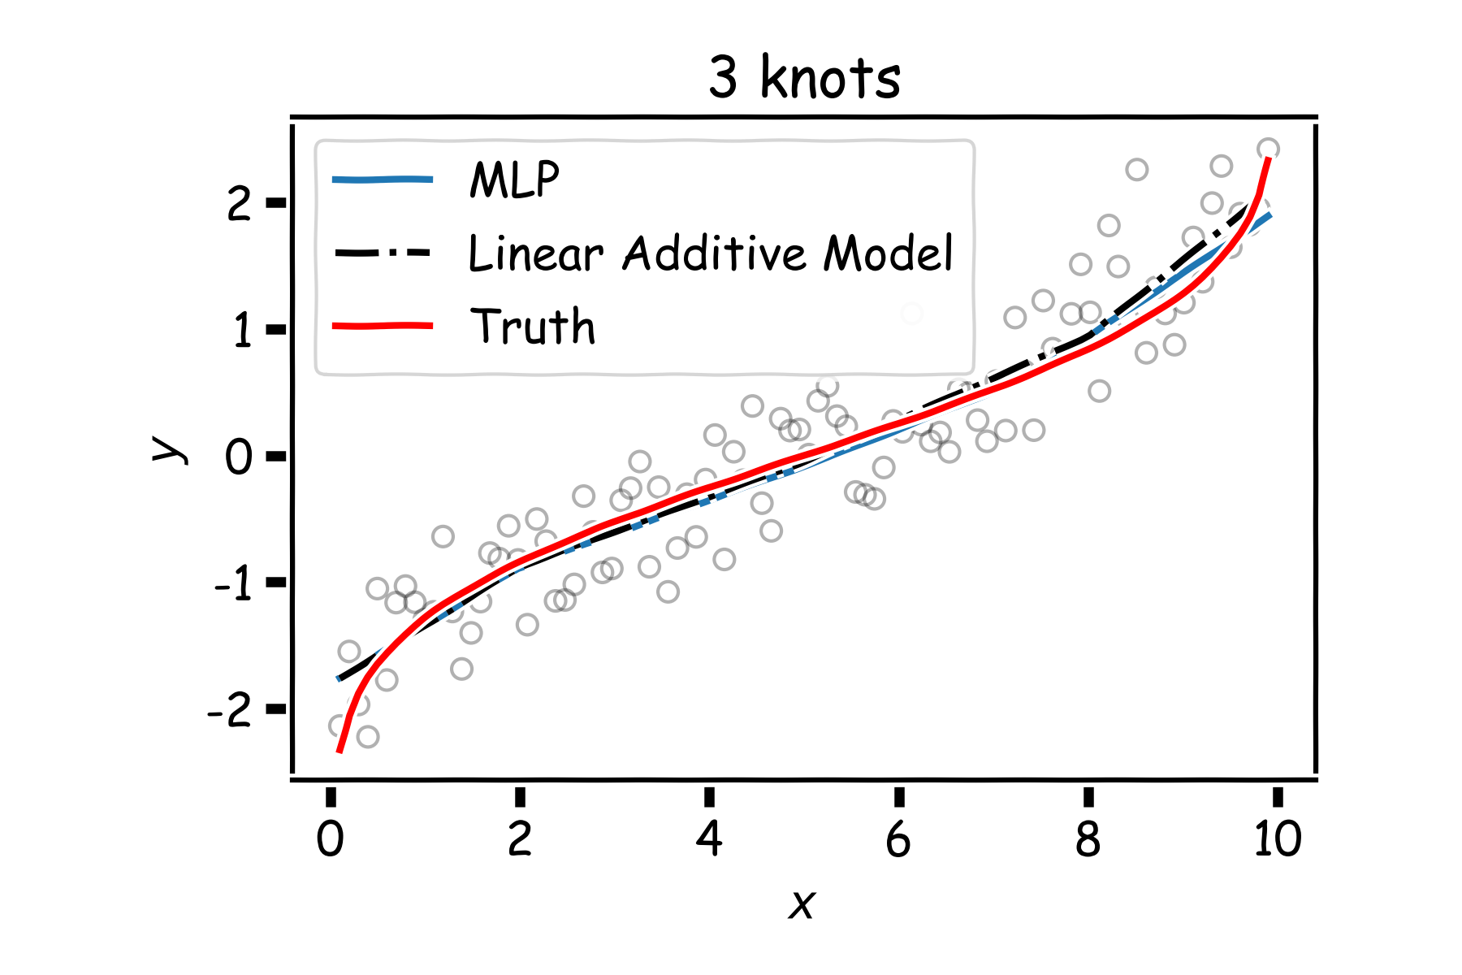
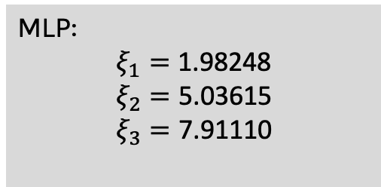
MLP as an additive model (cont)
MLP:
$$ξ_{1}=\text{1.98248}$$
$$ξ_{2}=\text{5.03615}$$
$$ξ_{3}=\text{7.91110}$$

Slide 26
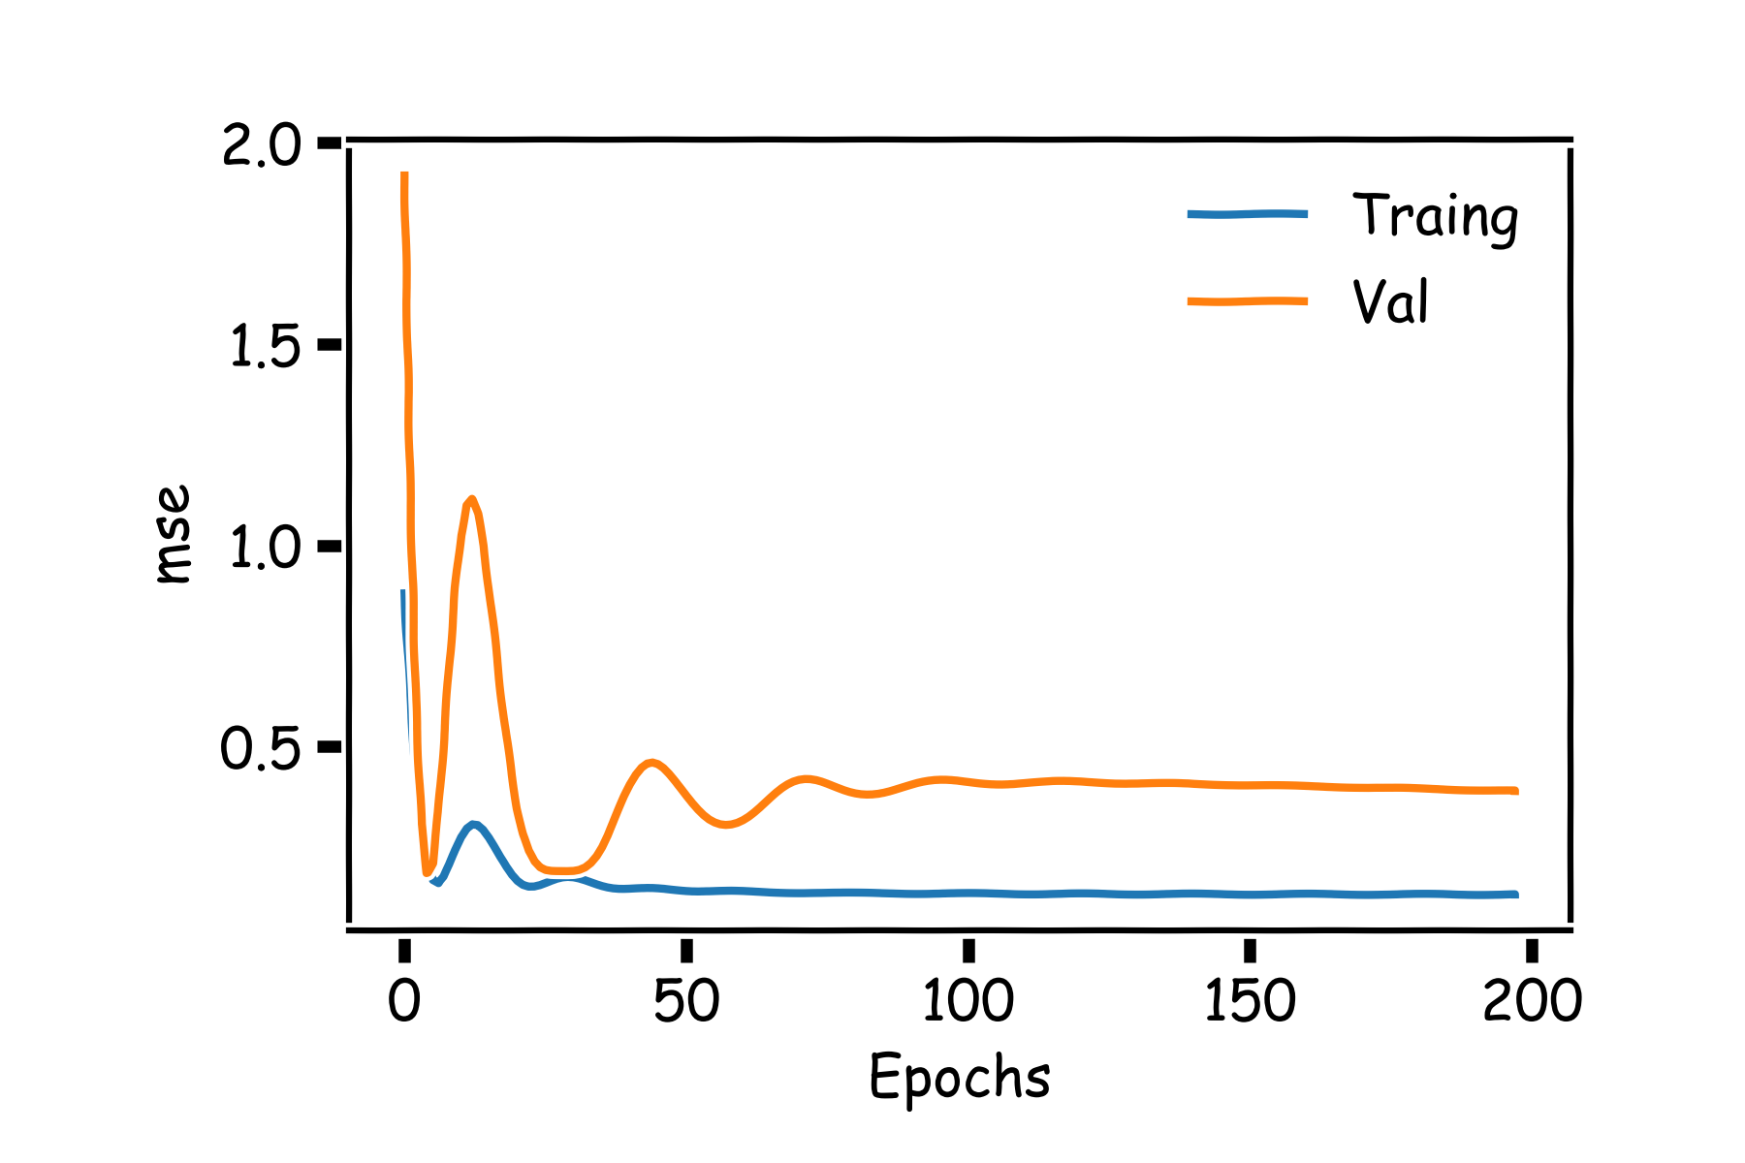
MLP as an additive model (cont)
If we add more neurons, it clearly overfits.
Regularization of NN
Norm Penalties
Early Stopping
Data Augmentation
Dropout
[batch normalization]

Slide 27
Main drawbacks of MLPs
MLPs use one node for each input (e.g. pixel in an image, or 3 pixel values in RGB case). The number of weights rapidly becomes unmanageable for large images.
Training difficulties arise, overfitting can appear.
MLPs react differently to an input (images) and its shifted version – they are not translation invariant.

Slide 28
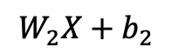
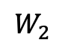
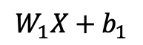
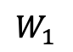
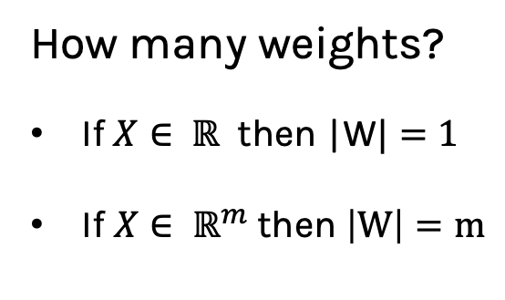
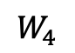
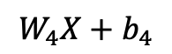
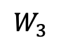
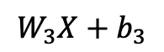
MLP: number of weights
$$W_{1}X+b_{1}$$
$$W_{1}$$
How many weights?
If $X∈ ℝ$ then |W$|=1$
If $X∈ ℝ^{m}$then $\left|W\right|=m$
$$W_{2}$$
$$W_{2}X+b_{2}$$
X
$$W_{3}$$
$$W_{4}$$
$$W_{3}X+b_{3}$$
input
$$W_{4}X+b_{4}$$
hidden layer 1

Slide 29

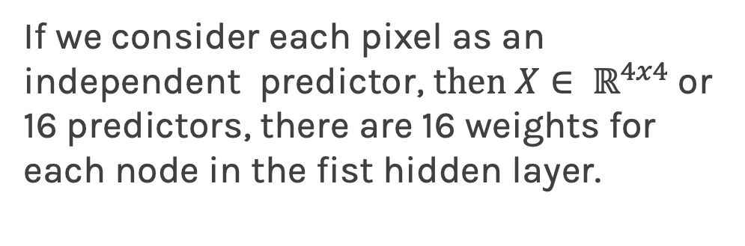
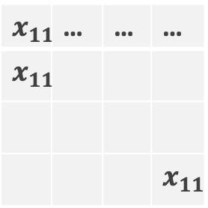
MLP: number of weights for images
If we consider each pixel as an independent predictor, t$hen X∈ ℝ^{4x4}$or 16 predictors, there are 16 weights for each node in the fist hidden layer.
$$x_{11}$$ | … | … | …
$$x_{11}$$
 |  |  | $$x_{11}$$
A strong motivation for performing model selection is to avoid overfitting, which can happen when:
there are too many predictors
the feature space is high dimensional
the polynomial degree is too high
too many cross-terms are considered

Slide 30

Common Dataset: MNIST
MNIST database is a large set of handwritten digits.
It contains 60,000 training images and 10,000 testing images.
Every image 28x28 pixel and anti-aliased, which introduced grayscale levels

Slide 31
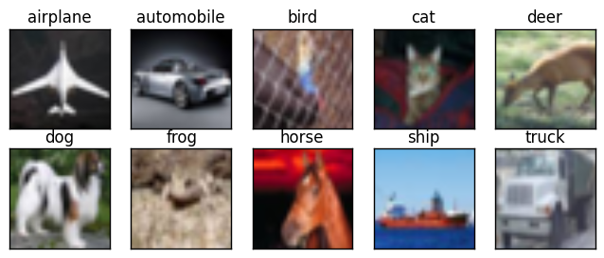
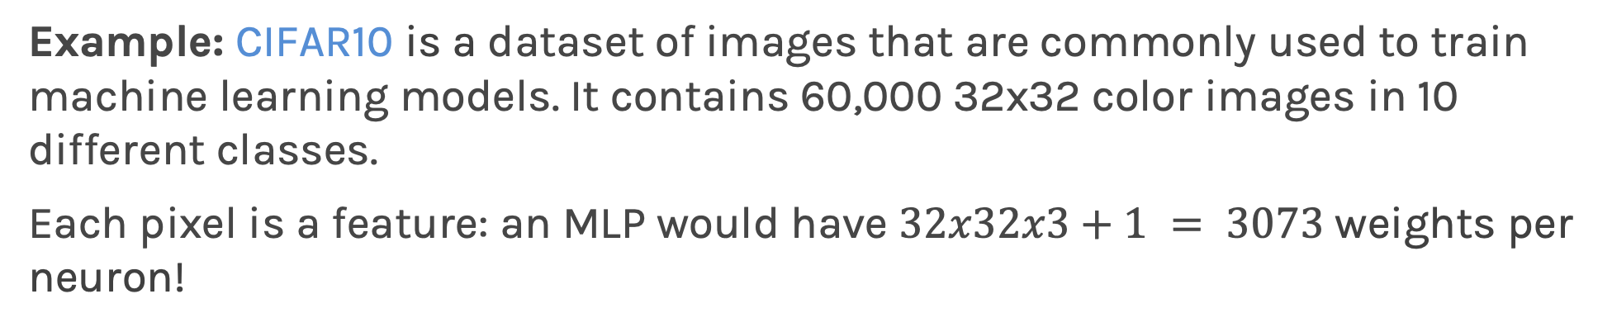
MLP: number of weights for images
Example: CIFAR10 is a dataset of images that are commonly used to train machine learning models. It contains 60,000 32x32 color images in 10 different classes.
Each pixel is a feature: an MLP would have $32x32x3+1 = 3073$weights per neuron!

Slide 32
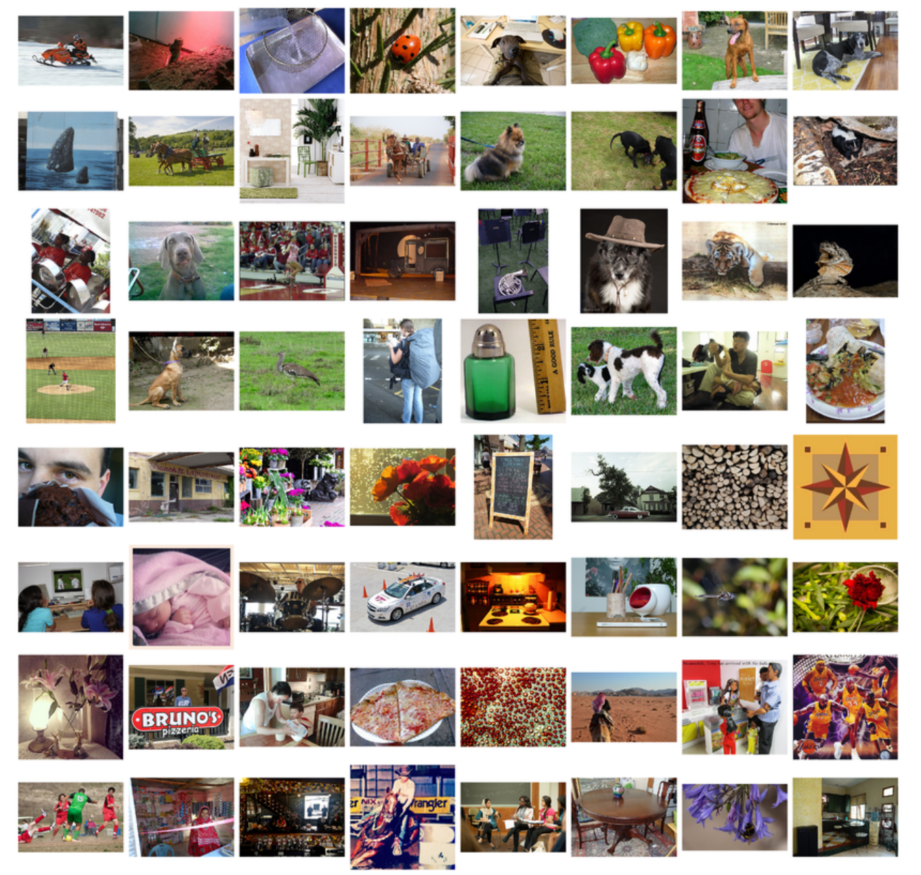
MLP: number of weights for images
Example: ImageNet is a large visual database designed for use in visual object recognition software research. More than 14 million images have been hand-annotated by the project to indicate what objects are pictured. In at least one million of the images, bounding boxes are also provided.
Images are usually 224x224x3: an MLP would have 150129 weights per neuron. If the first layer of the MLP is around 128 nodes, which is small, this already becomes very heavy to train.

Slide 34
Model Selection and Dimensionality Reduction
Recall from CS109A that to reduce the number of predictors we can:

Slide 35
Model Selection and Dimensionality Reduction
Recall from CS109A that to reduce the number of predictors we can:
PCA

Slide 36
Model Selection and Dimensionality Reduction
Recall from CS109A that to reduce the number of predictors we can:
PCA
Stepwise Variable Selection

Slide 37
Model Selection and Dimensionality Reduction
Recall from CS109A that to reduce the number of predictors we can:
PCA
Stepwise Variable Selection
Regularization, in particular L1 will produce sparsity

Slide 38
Model Selection and Dimensionality Reduction
Recall from CS109A that to reduce the number of predictors we can:
PCA
Stepwise Variable Selection
Regularization, in particular L1 will produce sparsity
Drop predictors that are highly correlated

Slide 39
Model Selection and Dimensionality Reduction
Recall from CS109A that to reduce the number of predictors we can:
PCA
Stepwise Variable Selection
Regularization, in particular L1 will produce sparsity
Drop predictors that are highly correlated
Summarize input (image) with high level features => feature extraction or representation learning

Slide 40
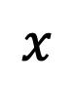
Feature extraction
Features:
Bald
Grey hair
Oval shape head
Glasses
$$x$$

Slide 41
Feature extraction
Features:
Bald
Grey hair
Oval shape head
Glasses
$$x$$
WAIT FOR IT

Slide 42
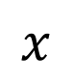
Feature extraction
Features:
Bald
Grey hair
Oval shape head
Glasses
Awesome
$$x$$

Slide 43
Feature extraction
Features:
Bald
Grey hair
Oval shape head
Glasses
Awesome
$$x$$
Features:
Bald
Grey hair
Oval shape head
No Glasses
Awesome

Slide 44

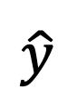
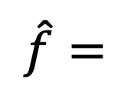
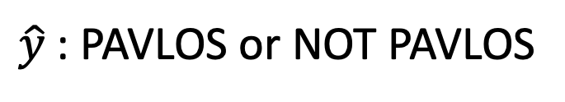
Feature extraction
Features:
Bald
Grey hair
Oval shape head
Glasses
Awesome
$\hat{y}$: PAVLOS or NOT PAVLOS
$$x$$
$$x′$$
$\hat{f}=$
$$\hat{y}$$
Features:
Bald
Grey hair
Oval shape head
No Glasses
Awesome

Slide 45
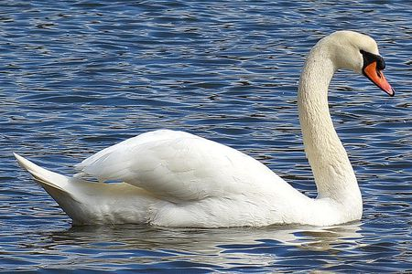
Image analysis
Imagine that we want to recognize swans in an image:
Slides from Camilo Fosco

Slide 46
Image analysis
Imagine that we want to recognize swans in an image:
Oval-shaped white blob (body)
Slides from Camilo Fosco

Slide 47
Image analysis
Imagine that we want to recognize swans in an image:
Round, elongated oval with orange protuberance
Oval-shaped white blob (body)
Slides from Camilo Fosco

Slide 48
Image analysis
Imagine that we want to recognize swans in an image:
Round, elongated oval with orange protuberance
Oval-shaped white blob (body)
Long white rectangular shape (neck)
Slides from Camilo Fosco

Slide 49
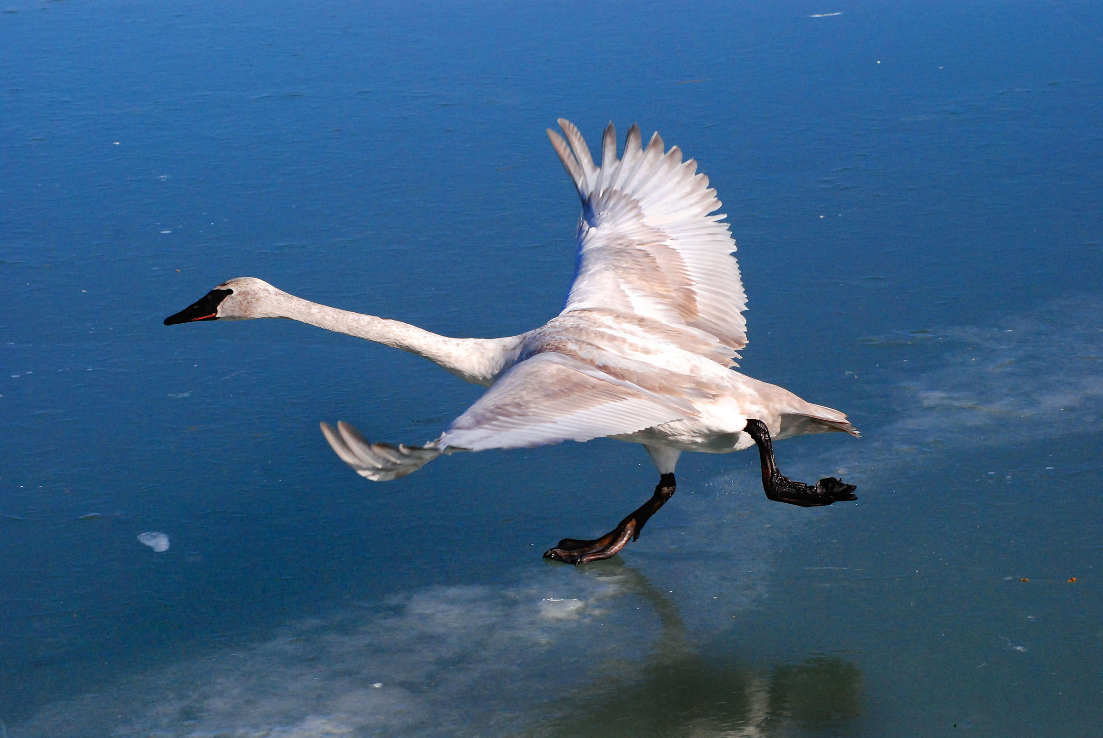
Cases can be a bit more complex…

Slide 50
Cases can be a bit more complex…
Round, elongated head with orange or black beak

Slide 51
Cases can be a bit more complex…
Round, elongated head with orange or black beak
Long white neck, square shape

Slide 52
Cases can be a bit more complex…
Round, elongated head with orange or black beak
Oval-shaped white body with or without large white symmetric blobs (wings)
Long white neck, square shape

Slide 53
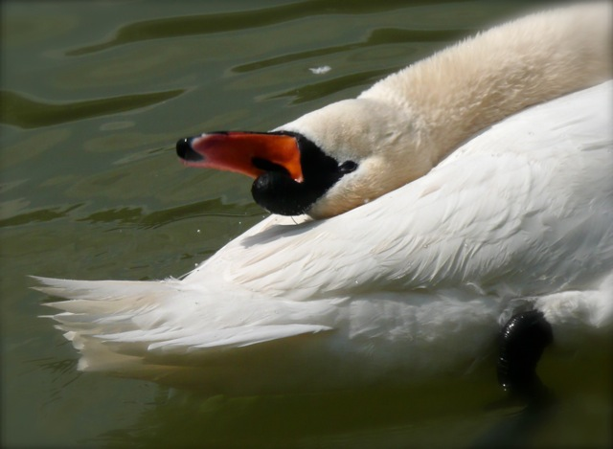
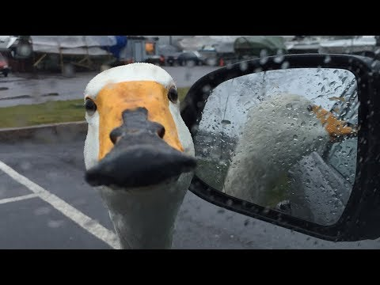
Now what?
Round, elongated head with orange or black beak, can be turned backwards
Long white neck, can bend around, not necessarily straight
White tail, generally far from the head, looks feathery
Black feet, under body, can have different shapes
White, oval shaped body, with or without wings visible

Slide 54
Now what?
Round, elongated head with orange or black beak, can be turned backwards
Small black circles, can be facing the camera, sometimes can see both
Long white neck, can bend around, not necessarily straight
Black triangular shaped form, on the head, can have different sizes
White tail, generally far from the head, looks feathery
White elongated piece, can be squared or more triangular, can be obstructed sometimes
Luckily, the color is consistent…
Black feet, under body, can have different shapes
White, oval shaped body, with or without wings visible

Slide 55
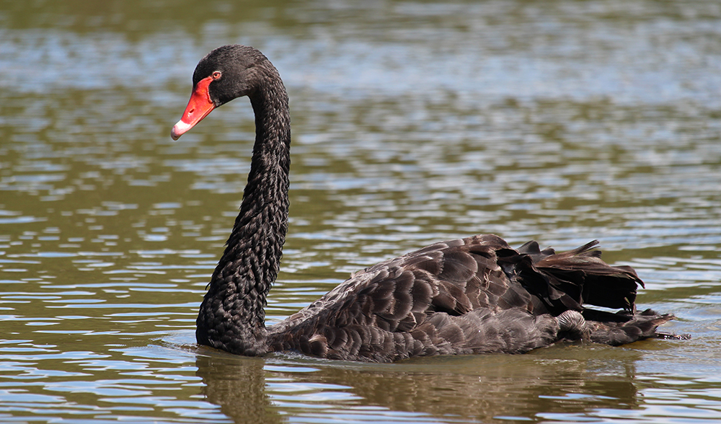
We need to be able to deal with these cases

Slide 56
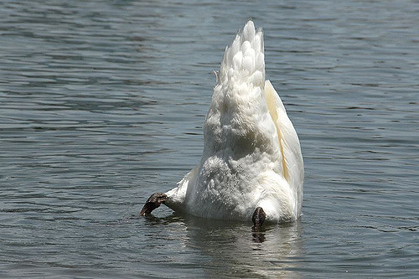
And these

Slide 57
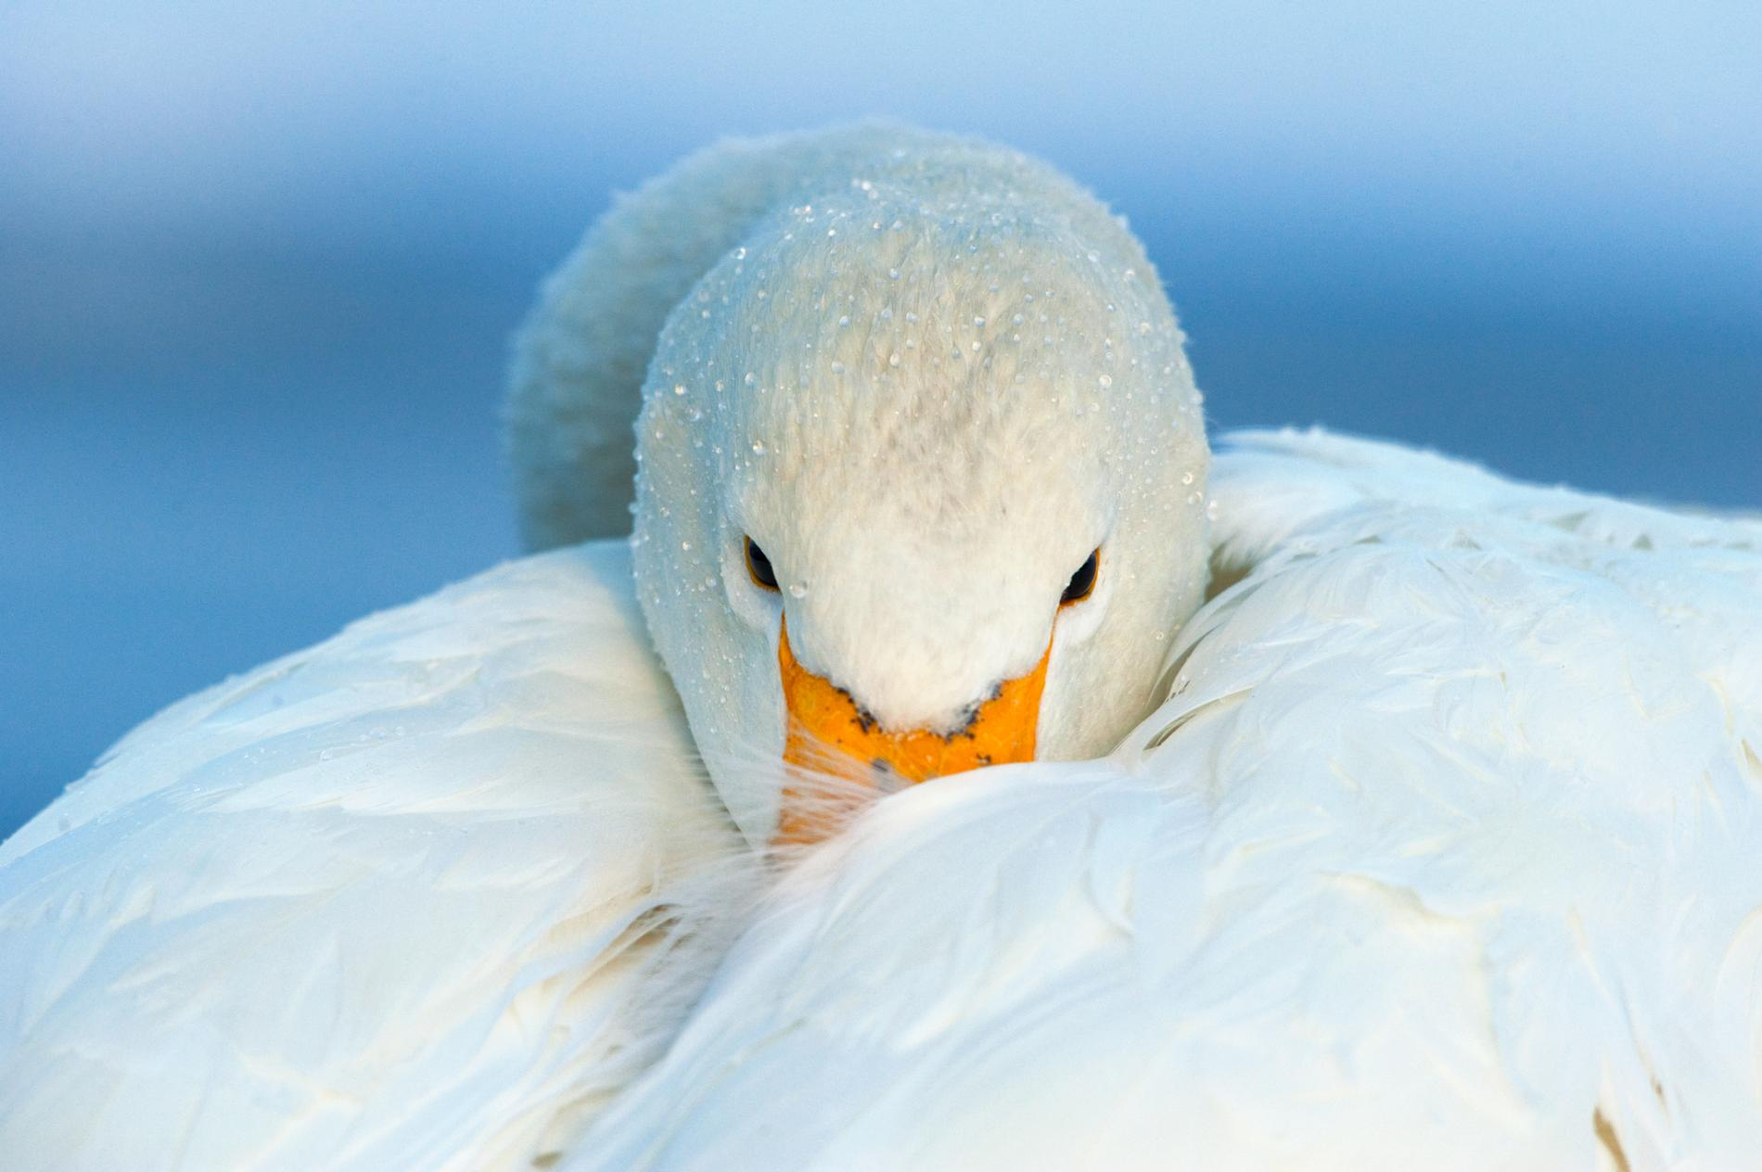
And these

Slide 58

And these

Slide 59

And these

Slide 60


Image features
We’ve been basically talking about detecting features in images in a very naïve way.
Researchers built multiple computer vision techniques to deal with these issues: SIFT, FAST, SURF, BRIEF, etc.
However, similar problems arose: the detectors where either too general or too over-engineered. Humans were designing these feature detectors, and that made them either too simple or hard to generalize.
SIFT feature descriptor
FAST corner detection algorithm

Slide 61
Image features (cont)
What if we learned the features?
We need a system that can do Representation Learning or Feature Learning.

Slide 62
Image features (cont)
What if we learned the features?
We need a system that can do Representation Learning or Feature Learning.
Representation Learning: technique that allows a system to automatically find relevant features for a given task. Replaces manual feature engineering.

Slide 63
Image features (cont)
What if we learned the features?
We need a system that can do Representation Learning or Feature Learning.
Representation Learning: technique that allows a system to automatically find relevant features for a given task. Replaces manual feature engineering.
Multiple techniques for this:
Unsupervised (K-means, PCA, …).
Supervised Dictionary learning
Neural Networks!

Slide 64

Some things to consider
Nearby Pixels are more strongly related that distant ones
Objects are built up out of smaller parts
Images are Local and Hierarchical

Slide 65




Images are Invariant

Slide 66
Outline
Motivation
CNN basic ideas
Building a CNN

Slide 67
Each neuron from the first layer has one weight per pixel. Recall that the importance of the predictors (here pixels) is given by the value of the coefficient (there the weight W)
In this case, the red weights will be larger to better recognize "cat”.
X
In this case, the blue weights will be larger.
X

Slide 68
Each neuron from the first layer has one weight per pixel. Recall that the importance of the predictors (here pixels) is given by the value of the coefficient (there the weight W)
X
We are learning redundant features. Approach is not robust, as cats could appear in yet another position.
X

Slide 69

Solution: Cut the image into smaller pieces.
$$X:ℝ^{8×8}$$
64 weights per neuron

Slide 70

Solution: Cut the image to smaller pieces.
$$X:ℝ^{4×4}$$
$$X:ℝ^{8×8}$$
64 weights per neuron

Slide 71
Solution: Cut the image to smaller pieces.
$$X:ℝ^{4×4}$$
$$X:ℝ^{8×8}$$
64 weights per neuron

Slide 72
Solution: Cut the image to smaller pieces.
$$X:ℝ^{4×4}$$
$$X:ℝ^{8×8}$$
64 weights per neuron

Slide 73
Solution: Cut the image to smaller pieces.
$$X:ℝ^{4×4}$$
$$X:ℝ^{8×8}$$
64 weights per neuron
16 weights per neuron but 4 times more training examples.

Slide 74
Do the same for all images
$$X:ℝ^{4×4}$$
$$X:ℝ^{8×8}$$
64 weights per neuron
16 weights per neuron but 4 times more training examples.

Slide 75
What if the cat is not entirely in one of the 4 boxes?

Slide 76
What if the cat is not entirely in one of the 4 boxes?
$$X:ℝ^{4×4}$$
$$X:ℝ^{8×8}$$
64 weights per neuron

Slide 77
What if the cat is not entirely in one of the 4 boxes?
$$X:ℝ^{4×4}$$
$$X:ℝ^{8×8}$$
64 weights per neuron

Slide 78
What if the cat is not entirely in one of the 4 boxes?
$$X:ℝ^{4×4}$$
$$X:ℝ^{8×8}$$
16 weights per neuron but 25 times more training examples.
64 weights per neuron
Sliding Window

Slide 79





Convolution
$$x_{11}$$
$$h_{11}=f\left(W_{11}x_{11}+W_{12}x_{12}+…+W_{44}x_{44}+b\right)$$
$$x_{12}$$
$$⋮$$
$$⋮$$
16 weights
$$x_{44}$$
Index here represents the cutout
Input
Hidden Layer

Slide 80












Convolution
$$x_{11}$$
$$h_{11}=f\left(W_{11}x_{11}+W_{12}x_{12}+…+W_{44}x_{44}+b\right)$$
$$x_{12}$$
$$⋮$$
$$⋮$$
16 weights
$$x_{44}$$
Input
Hidden Layer
$$W_{11}$$
$$W_{12}$$
$$W_{13}$$
$$W_{14}$$
$$x_{11}$$
$$x_{12}$$
$$x_{13}$$
$$x_{14}$$
$$h_{11}=∑$$
$$⋆$$
$$W_{44}$$
$$x_{44}$$
Element wise multiplication and addition of all products

Slide 81









Convolution
$$x_{11}$$
$$h_{12}=f\left(W_{11}x_{11}+W_{12}x_{12}+…+W_{44}x_{44}+b\right)$$
$$x_{12}$$
$$⋮$$
$$⋮$$
16 weights
$$x_{44}$$
Input
Hidden Layer
$$W_{11}$$
$$W_{12}$$
$$W_{13}$$
$$W_{14}$$
$$x_{11}$$
$$x_{12}$$
$$x_{13}$$
$$x_{14}$$
$$h_{12}=∑$$
$$⋆$$
$$W_{44}$$
$$x_{44}$$
Element wise multiplication and addition of all products

Slide 82












Convolution
$$W_{11}$$
$$W_{12}$$
$$W_{13}$$
$$W_{14}$$
$$x_{11}$$
$$x_{12}$$
$$x_{13}$$
$$x_{14}$$
$$h_{ij}=∑$$
$$⋆$$
$$W_{44}$$
$$x_{44}$$

Slide 83

Convolution
$$W_{11}$$
$$W_{12}$$
$$W_{13}$$
$$W_{14}$$
$$x_{11}$$
$$x_{12}$$
$$x_{13}$$
$$x_{14}$$
$$h_{ij}=∑$$
$$⋆$$
$$W_{44}$$
$$x_{44}$$
KERNEL, K
X is the cutout of image center at $\{i,j$}

Slide 84


Convolution
$$W_{11}$$
$$W_{12}$$
$$W_{13}$$
$$W_{14}$$
$$x_{11}$$
$$x_{12}$$
$$x_{13}$$
$$x_{14}$$
$$h_{ij}=∑$$
$$⋆$$
$$W_{44}$$
$$x_{44}$$
Index here represents the output from this operation
KERNEL, K
X is the cutout of image center at $\{i,j$}
Element wise multiplication and addition of all products
$$=$$
CONVOLUTION
$$H=K⋆X$$

Slide 85


Convolution and cross-correlation
A convolution of $f$ and $g$, $(f∗g)$, is defined as the integral of the product, having one of the functions inverted and shifted:
$$\left(f∗g\right)\left(t\right)=\int_{a}{f\left(a\right)g\left(t−a\right)da}$$
Discrete convolution:
$$\left(f∗g\right)\left(t\right)=\sum_{a=−∞}^{∞}{f\left(a\right)g(t−a)}$$
Discrete cross-correlation:
Function is inverted and shifted left by t
$$\left(f⋆g\right)\left(t\right)=\sum_{a=−∞}^{∞}{f\left(a\right)g(t+a)}$$

Slide 86

“Convolution” Operation
Source Pixel
(-1x3)+(0x0)+(1x1)+ (-2x2)+(0x6)+(2x2)+
(-1x2)+(0x4)+(1x1)=-3
Convolution Kernel [WE’LL NEED TO LEARN IT]
Destination Pixel
Kernel Map

Slide 87


Convolutions – step by step

Slide 88

Convolutions – another example

Slide 89
“Convolution” Operation in action
What does convolving an image with a Kernel do?
wikipedia.org

Slide 90
“Convolution” Operation in action
What does convolving an image with a Kernel do?
Kernel
Edge detection
*
=
Sharpen
*
=

Slide 91
A Convolutional Network
+ ReLU
Why is there more than one layer?
+ ReLU
What is this square?
What are feature maps and why are there multiple feature maps?
What is going on here?
What is Pooling?

Slide 92
A Convolutional Network
+ ReLU
Why is there more than one layer?
+ ReLU
What is this square?
What are feature maps and why are there multiple feature maps?
What is going on here?
What is Pooling?

Slide 93

“Convolution” Operation
RGB Image
(7x7x3)
Convolution Filter
(3x3x3)
Convolution Kernels
Feature Map
(7x7x1)

Slide 94
A Convolutional Network
+ ReLU
Why is there more than one layer?
+ ReLU
What are feature maps and why are there multiple feature maps?
What is going on here?
What is Pooling?

Slide 95
Why more than one feature map?
LAYER 1:

Slide 96
Why more than one feature map?
LAYER 1:
Filter 1: Horizontal Lines

Slide 97
Why more than one feature map?
LAYER 1:
Filter 1: Horizontal Lines
Filter 2: Vertical Lines

Slide 98
Why more than one feature map?
LAYER 1:
Filter 1: Horizontal Lines
Filter 2: Vertical Lines
Filter 3: Orange bulb

Slide 99
Why more than one feature map?
LAYER 1:
Filter 1: Horizontal Lines
Filter 2: Vertical Lines
Filter 3: Orange bulb
Different filters identify different features.

Slide 100

“Convolution” Operation
RGB Image
(7x7x3)
3 Convolution Filters
(3x3x3)
3 Feature Maps
(7x7x3)

Slide 101
A Convolutional Network
+ ReLU
Why is there more than one layer?
+ ReLU
What are feature maps and why are there multiple feature maps?
What is going on here?
What is Pooling?

Slide 102
Why more than one layer?

Slide 103
Why more than one layer?
Layer 2, Filter 1: Combines horizontal and vertical lines from Layer 1 produce diagonal lines.

Slide 104
Why more than one layer?
Layer 2, Filter 1: Combines horizontal and vertical lines from Layer 1 produce diagonal lines.
Layer 3, Filter 1: Combines diagonal lines to identify shapes

Slide 105
A Convolutional Network
+ ReLU
Why is there more than one layer?
+ ReLU
What is Pooling?
What is going on here?

Slide 106
So far:
We know that MLPs:
Do not scale well for images
Ignore the information brought by pixel position and correlation with neighbors
Cannot handle translations

Slide 107
So far:
We know that MLPs:
Do not scale well for images
Ignore the information brought by pixel position and correlation with neighbors
Cannot handle translations
The general idea of CNNs is to intelligently adapt to properties of images:
Pixel position and neighborhood have semantic meanings.
Elements of interest can appear anywhere in the image.

Slide 108




Convolutions – what happens at the edges?
If we apply convolutions on a normal image, the result will be down-sampled by an amount depending on the size of the filter.
We can avoid this by padding the edges in different ways.

Slide 109


Padding
Full padding. Introduces zeros such that all pixels are visited the same number of times by the filter. Increases size of output.
Same padding. Ensures that the output has the same size as the input.

Slide 110



Stride
Stride controls how the filter convolves around the input volume.
The formula for calculating the output size is:
Where O is output dim, W is the input dim, K is the filter size, P is padding and S the stride
Stride = 1
Stride = 2
$$O=\frac{W−K+2P}{S}+1$$

Slide 111


Exercise: Pavlos vs Not Pavlos
The aim of this exercise is to train a dense neural network and a CNN to compare the parameters between them
Augment the dataset since we only have one image of Pavlos and the eagle
Build a simple feed-forward network and train it
Use the convolution layer to build a simple CNN and train it like the network before
Compare performance and parameters

Slide 112
A Convolutional Network
+ ReLU
+ ReLU
What is Pooling?
What is going on here?

